Slide 1

NPTEL
Applied Accelerated Artificial Intelligence
Instructor: Dr. Satyajit Das
Dept. of Computer Science and Engineering
Indian Institute of Technology Guwahati, Assam, India

Slide 2
Week 01: AI System Hardware & Accelerators
Segment 1: CPU Architecture | Segment 2: Memory Hierarchy | Segment 3: GPU & Accelerators | Segment 4: Interconnects | Segment 5: AI Software Stack

Slide 3
Segment 1: CPU Architecture and AI Workloads
Understanding how CPUs are structured and why AI demands more than a general-purpose processor

Slide 4
Learning Objectives - Segment 1
01
Describe the key microarchitectural components of a modern CPU (pipeline, cache, ALU)
02
Explain Instruction-Level Parallelism (ILP) and its limits for AI workloads
03
Differentiate latency-optimised (CPU) vs. throughput-optimised (GPU) designs
04
Identify why FLOPS, memory bandwidth, and cache capacity are critical AI metrics
05
Analyse the von Neumann bottleneck and its impact on DNN inference

Slide 5
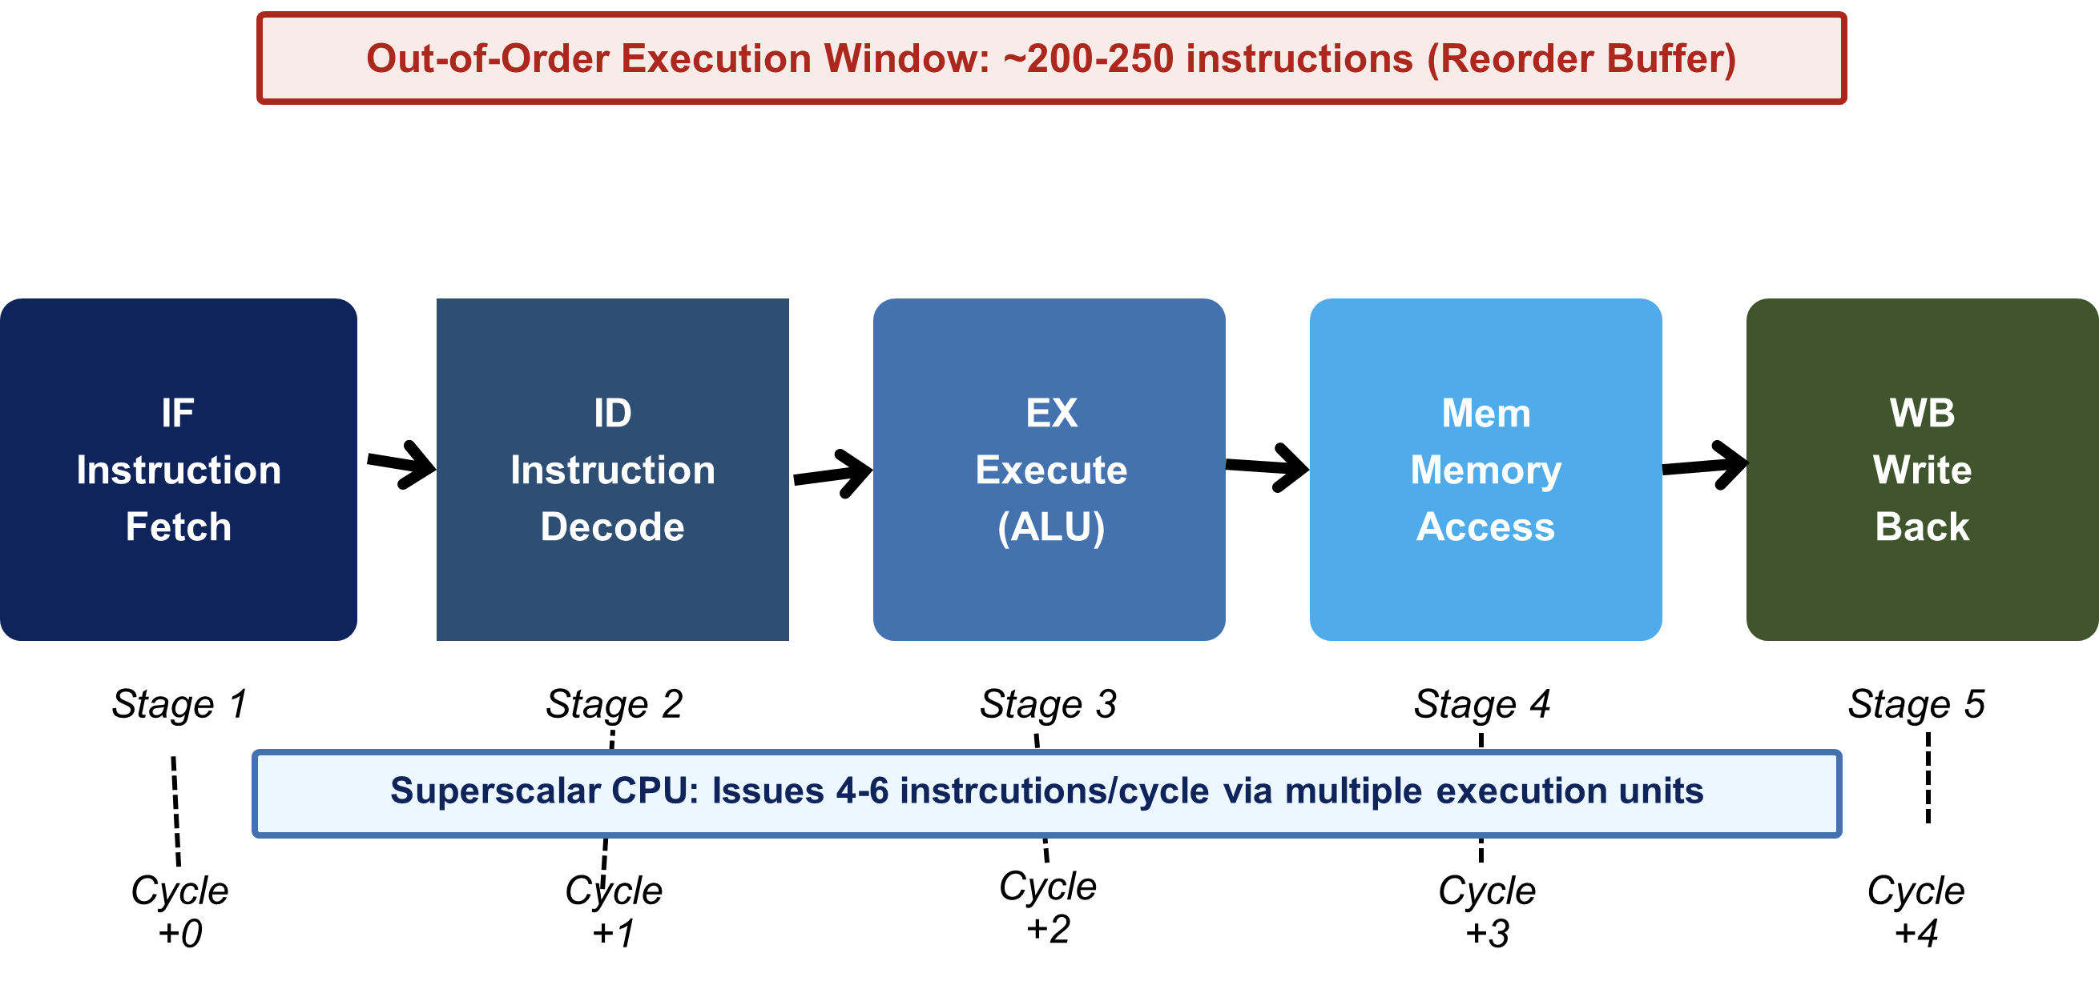
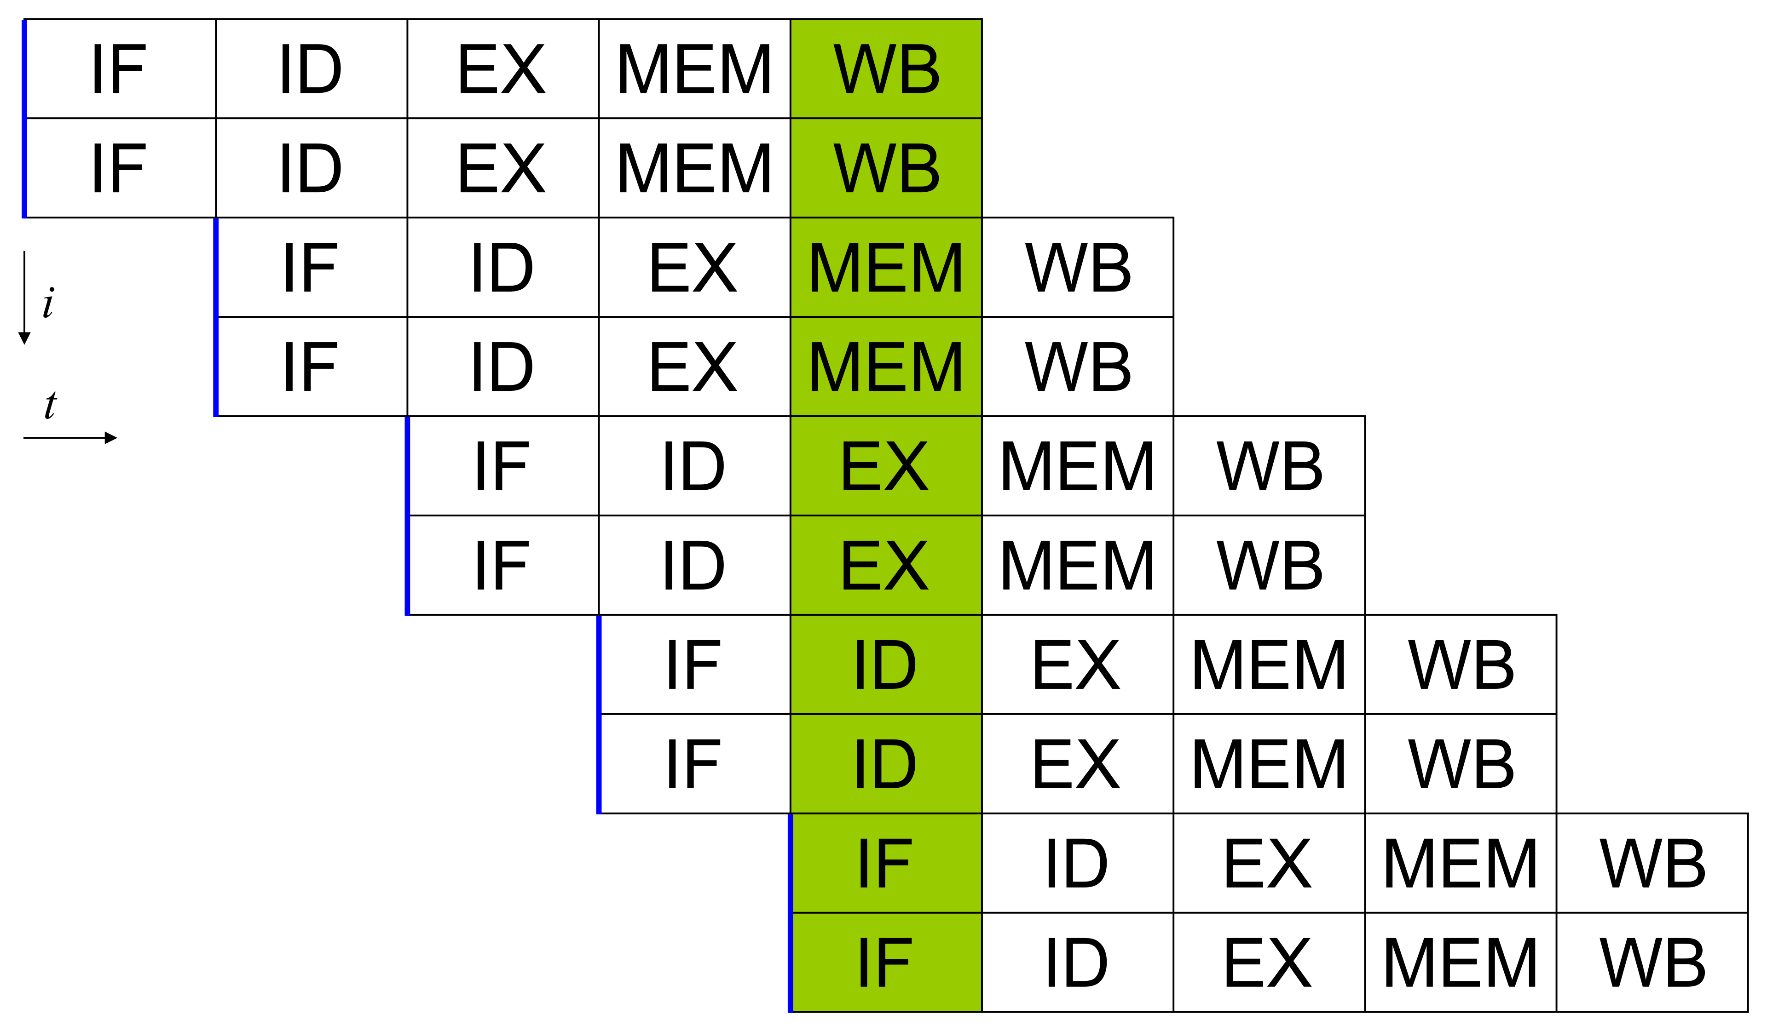
CPU Microarchitecture: The Building Blocks
Core Components
Fetch-Decode-Execute-Writeback pipeline stages
Superscalar execution: multiple execution units per cycle
Out-of-Order (OoO) execution for instruction-level parallelism
Branch predictor reduces pipeline stalls on conditional branches
Fig 1: CPU 5-Stage Pipeline
Superscalar - Source: Wikipedia

Slide 6
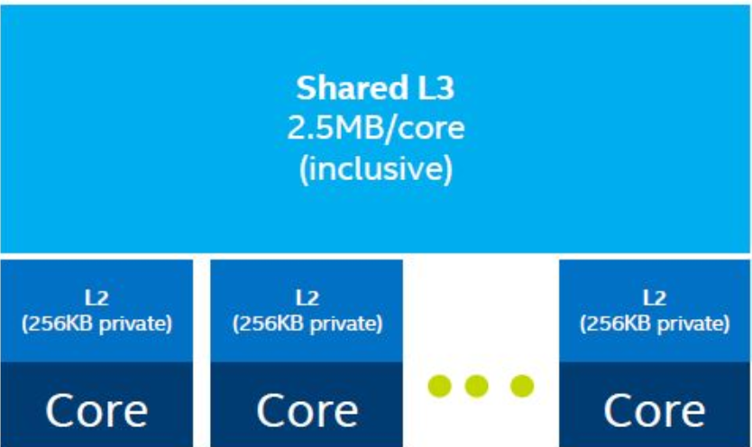
CPU Microarchitecture: The Building Blocks
Cache Hierarchy (Intel Xeon example)
L1: ~32 KB per core, ~4 cycle latency, per-core private
L2: ~256 KB per core, ~12 cycle latency, per-core private
L3: 30-60 MB shared, ~40 cycle latency, shared across cores
DRAM: GBs capacity, ~200+ cycle latency (the “memory wall”)
Ref: Patterson & Hennessy, “Computer Organization and Design,” 6th Ed. (2021)

Slide 7
CPU Microarchitecture: The Building Blocks
Modern CPU Specifications (AI Context)
AMD EPYC 9654: 96 cores, 384 MB L3, 12-ch DDR5
Intel Xeon Max 9480: 60 cores + HBM2e on-package
Peak FP32: ~4-6 TFLOPS (CPU) vs ~1000 TFLOPS (GPU)
Memory BW: ~300 GB/s (CPU DDR5) vs ~3.35 TB/s (H100 HBM3)
Key Insight
CPUs excel at serial, branchy, latency-sensitive workloads.
AI training/inference is a massively parallel GEMM problem.
Ref: Patterson & Hennessy, “Computer Organization and Design,” 6th Ed. (2021)

Slide 8
ILP, SIMD, and the Parallelism Gap
Instruction-Level Parallelism (ILP)
Superscalar CPUs issue 4-6 instructions per cycle via multiple execution ports
OoO window: ~200-250 instructions (reorder buffer) - inherently limited
Data hazards (RAW, WAR, WAW) and control hazards cap effective ILP
SIMD Extensions: Data-Level Parallelism
SSE (128-bit): 4x FP32 per cycle introduced in 1999 (Pentium III)
AVX-512 (512-bit): 16x FP32 per cycle, key for inference on CPUs
AMX (Intel): Matrix tiles up to 1024 bytes, accelerates GEMM on-chip
The Parallelism Gap
A ResNet-50 inference needs ~4 billion multiply-accumulate (MAC) operations
96-core EPYC with AVX-512: ~12 TFLOPS | NVIDIA H100: ~2000 TFLOPS (TF32)
For training LLMs, CPU-only is 100-1000x slower than GPU-based systems
Ref: Williams, Waterman, Patterson. “Roofline: An Insightful Visual Model.” CACM 2009

Slide 9
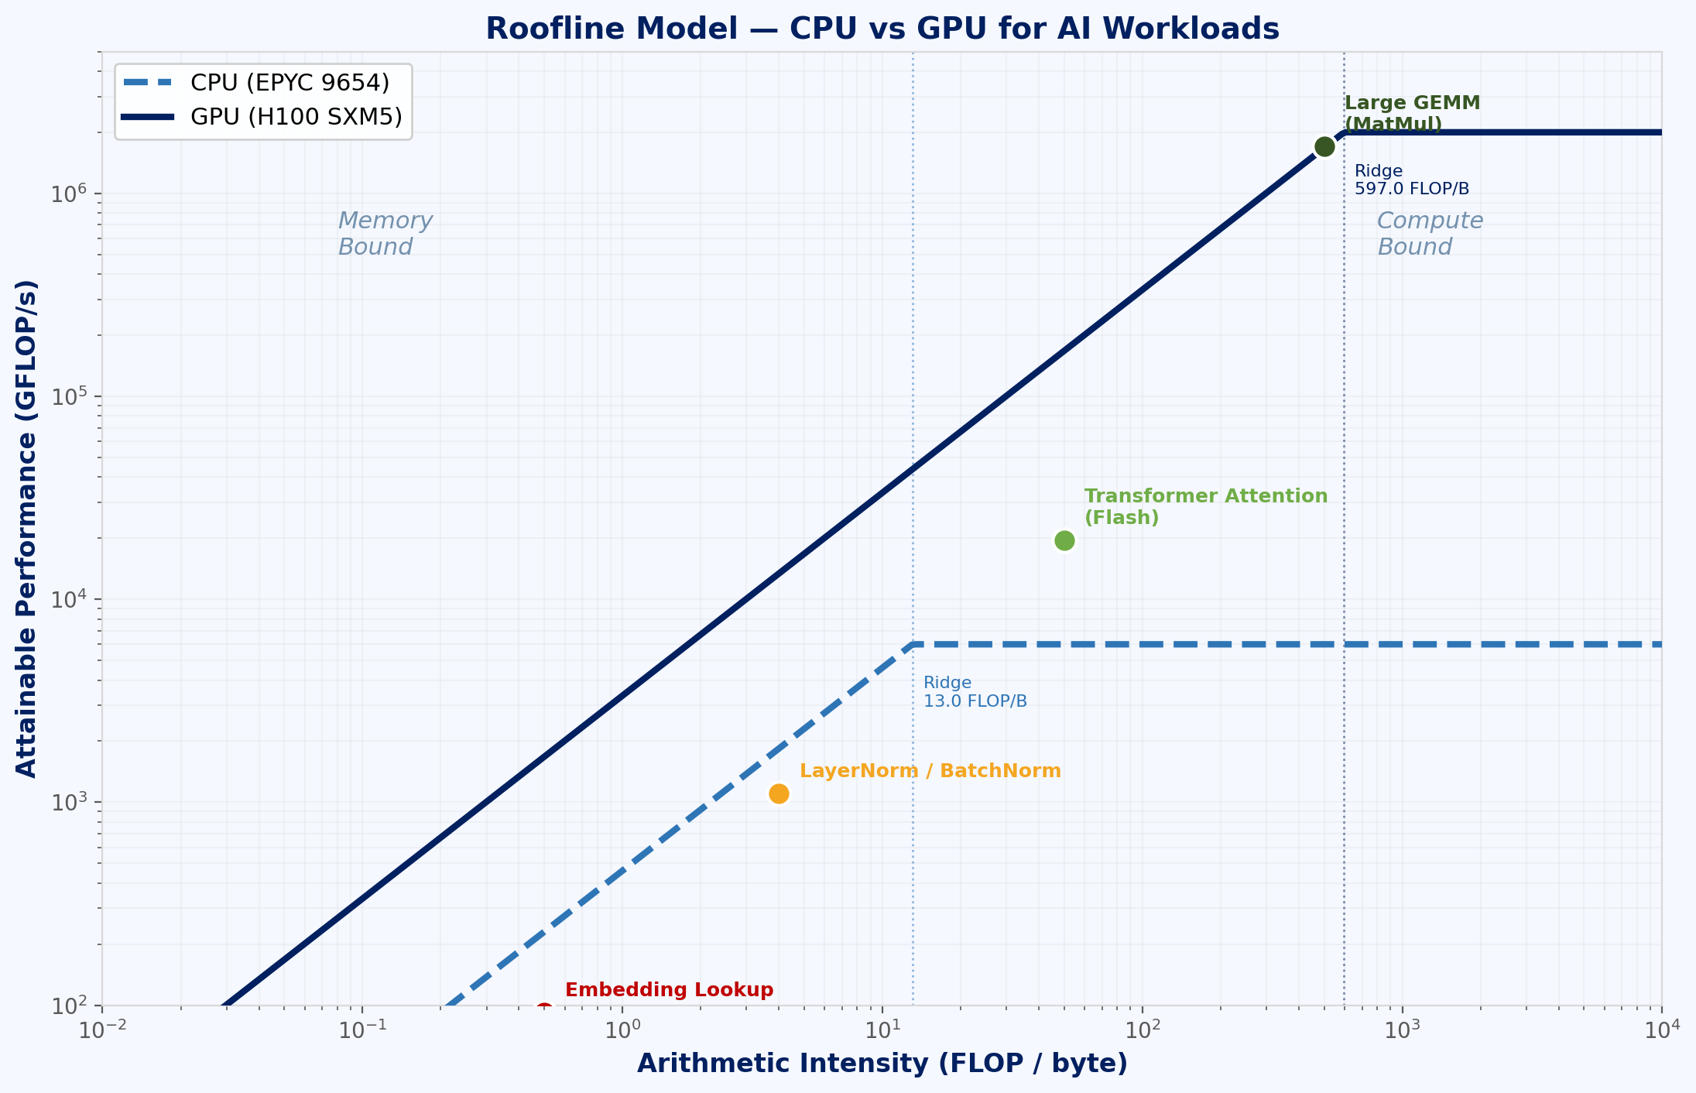
ILP, SIMD, and the Parallelism Gap
The Parallelism Gap
A ResNet-50 inference needs ~4 billion multiply-accumulate (MAC) operations
96-core EPYC with AVX-512: ~12 TFLOPS | NVIDIA H100: ~2000 TFLOPS (TF32)
For training LLMs, CPU-only is 100-1000x slower than GPU-based systems
Fig 2: Roofline Model — CPU vs GPU for AI
Ref: Williams, Waterman, Patterson. “Roofline: An Insightful Visual Model.” CACM 2009

Slide 10
Von Neumann Bottleneck & the Memory Wall
Arithmetic Intensity
Ratio: FLOPs performed per byte of memory traffic
GEMM (large): ~1000 FLOP/byte - compute bound on GPU
Embedding lookup: ~1 FLOP/byte - memory bound everywhere
Batch Norm, LayerNorm: ~3-5 FLOP/byte - memory bound
Fig 2: Roofline Model — CPU vs GPU for AI
Ref: Wulf & McKee, “Hitting the Memory Wall,” ACM SIGARCH 1995; Hennessy & Patterson, Turing Lecture 2018

Slide 11
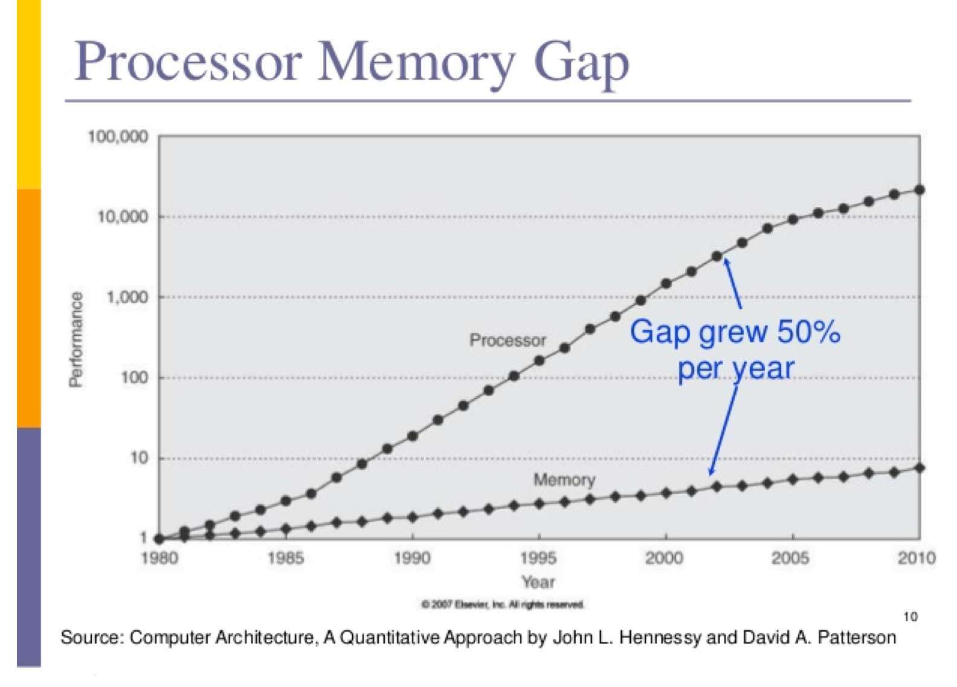
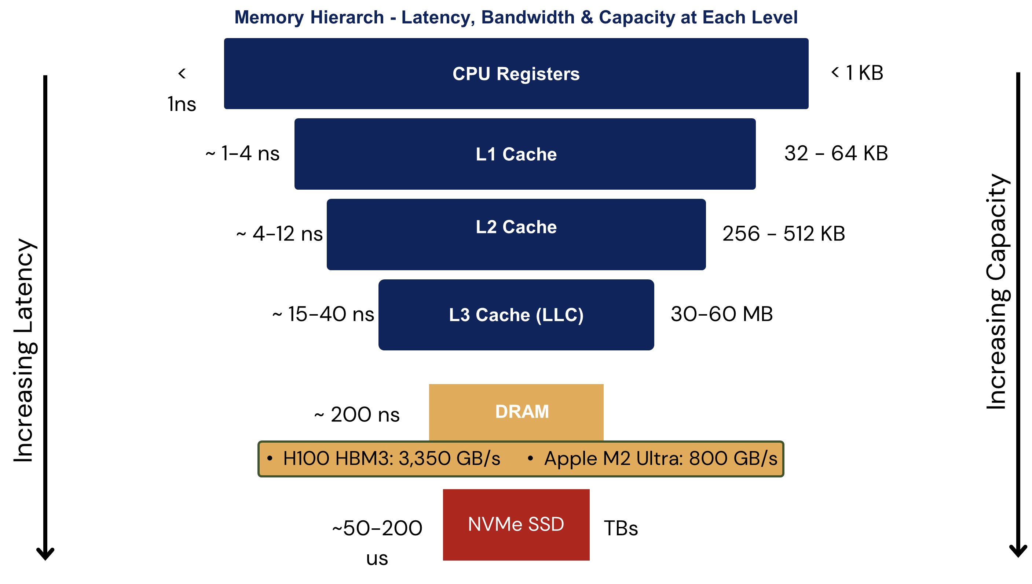
Von Neumann Bottleneck & the Memory Wall
The Von Neumann Architecture
Single shared bus between CPU and memory for both data and instructions
Memory access is serialised; compute units starve while waiting for data
The Memory Wall (Wulf & McKee, 1995)
CPU clock speeds grew ~60% per year (1987-2002) - now plateaued
DRAM bandwidth grew ~10% per year - the gap widened catastrophically
Modern DRAM latency ~60 ns; cache miss penalty = 200+ cycles
Fig 3: Memory Hierarchy — Latency, Bandwidth & Capacity
Ref: Wulf & McKee, “Hitting the Memory Wall,” ACM SIGARCH 1995; Hennessy & Patterson, Turing Lecture 2018

Slide 12
Von Neumann Bottleneck & the Memory Wall
Impact on AI Workloads
Transformer attention: O(n²) memory access pattern per layer
LLM inference: memory-bound (load weights each token generation step)
DNN training: compute-bound (large mini-batches fill arithmetic units)
For a 70-billion-parameter model in FP16, that is 140 gigabytes of data — loaded every single token generation step. At 400 GB/s bandwidth, that takes 350 milliseconds per token. That is the bottleneck.
Fig 3: Memory Hierarchy — Latency, Bandwidth & Capacity
Ref: Wulf & McKee, “Hitting the Memory Wall,” ACM SIGARCH 1995; Hennessy & Patterson, Turing Lecture 2018

Slide 13
CPUs in the AI Pipeline: Where They Still Excel
Pre/Post Processing: CPU’s Domain
Data ingestion, tokenisation, and augmentation are branchy and irregular - ideal for CPUs
OpenCV image decoding, librosa audio processing, NLTK/spaCy text parsing
Dataset shuffling, batching, and prefetching managed by CPU DataLoader workers
Model Components That Remain on CPU
Sparse operations (variable-length sequences, dynamic graphs in PyTorch)
Control flow in reinforcement learning environments (step(), reset())
ONNX Runtime on CPU: viable for lightweight models (<10M params) in production
Heterogeneous Computing Philosophy
CPU: orchestration, control flow, serial computations, IO management
GPU/Accelerator: massively parallel tensor operations (GEMM, Conv, Attn)
Always profile before offloading - PCIe transfer overhead can dominate for small ops
Key Metric: Use nvidia-smi to check GPU utilisation; if <60%, CPU is the bottleneck
Rule of Thumb: GPU-CPU data transfer at ~16 GB/s (PCIe 4.0 x16) vs 3.35 TB/s GPU memory
Ref: NVIDIA Nsight Systems; Raschka et al., “Machine Learning with PyTorch and Scikit-Learn” (2022)

Slide 14
Summary: CPU Architecture & AI Workloads
CPUs use deep pipelines, caches, OoO execution, and SIMD for latency-optimised serial computation
The memory wall and von Neumann bottleneck constrain CPU performance for data-heavy AI tasks
SIMD extensions (AVX-512, AMX) partially close the gap but cannot match GPU-scale parallelism
Arithmetic intensity determines whether a workload is compute-bound or memory-bound on any architecture
CPUs remain essential for data preprocessing, orchestration, and sparse/control-flow-heavy tasks in AI pipelines

Slide 15
Thank you!

